Slide 1
Racino: A Solution or A Terminator?
Shuang Liu
Macao Polytechnic Institute
1-4 December 2013, Gaohsiung, Taiwan

Slide 2
Outline
Concept
Purpose
Case
Future
Notes:
Purpose of racinos, why racinos become more and more popular?
Case of Macao
The future of racinos in Macao

Slide 3
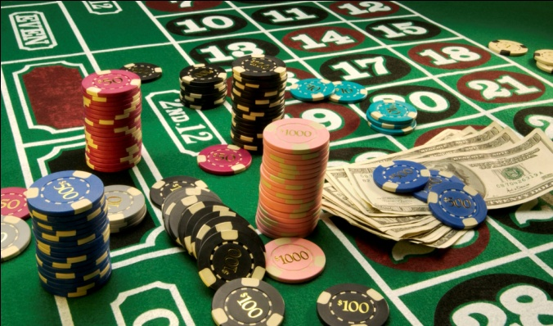
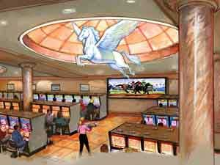
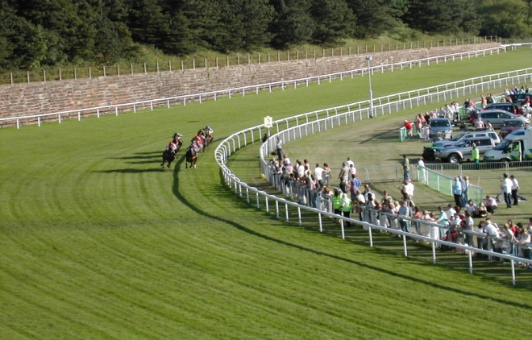
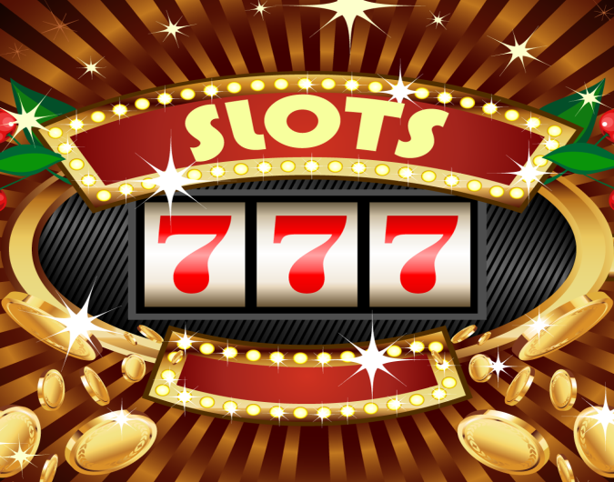
What is Racino
+
=

Slide 4
(1) racinos in the world
US (43): in 14 states
Canada (28): in 6 provinces
UK: Wolverhampton Racecourse
Austria: Magna Racino
Philiphins: San Lazaro Leisure Park
Macao: Yat Yuen Canidrome Slot Lounge, Macau Jockey Club Slot Lounge
Notes:
Casinos in USA: over the last 25 years from operating only in Nevada and Atlantic City, New Jersey to operating 566 casinos in 22 states in 2010.
USA: More than 43 racinos in 14 states. Twin River Casino and Racing, the 1st racino opened in 1992 in Rhode Island (1). In 1994, 4 additional states – Delaware (3), Iowa (2), Louisiana (3), and West Virginia (4) - legalized racinos. In 2006, racinos opened in Florida (10) and Pennsylvania (4). Other states with racinos are: Maine (1), New Mexico (5), New York (7) and Oklahoma (3).
Canada (28): 28 racinos in 6 provinces, including Alberta (2, Evergreen Park, Horses and Slots at Northlands Park), British Columbia (2, Fraser Downs, Hastings Racecourse), Manitoba (1, Assiniboia Downs Gaming), Ontario (17, Ajax Downs, Clinton Raceway, Dresden Raceway, Flamboro Downs, Fort Erie Racetrack and Slots, Georgian Downs, Grand River Raceway, Hanover Raceway, Hiawatha Horse Park and, Entertainment Center, Kawartha Downs, Mohawk Racetrack, Rideau Carleton Raceway, Sudbury Downs, Western Fair Raceway, Windsor Raceway, Woodbine Entertainment, Woodstock Raceway), Prince Edward Island (1, Charlottetown Driving Park Entertainment Centre) and Quebec (4, Hippodrome d'Aylmer, Hippodrome de Montreal, Sulky Quebec, Sulky Trois-Rivieres)
UK (1): Wolverhampton Racecourse. Wolverhampton Racecourse was Britain's first floodlit horse racing track. In terms of number of races, Wolverhampton is the busiest racecourse in the UK.
Austria (1): Magna Racino in Ebreichsdorf, about 20 miles south of Vienna.
Philiphins (1): San Lazaro Leisure Park, located in Carmona, Cavite, about minutes south of Manila.
http://www.racinos.net/

Slide 5
(2) top 10 US racetrack casino markets by annual revenue 2012
Ranking | Racetrack Casino Market | Annual Revenues
1 | Philadelphia, Pa. | $835.33 million
2 | New York City, N.Y. | $672.57 million
3 | Yonkers, N.Y. | $544.70 million
4 | Charles Town, W.V. | $536.99 million
5 | Providence, R.I. | $477.83 million
6 | Indianapolis, Ind. | $445.40 million
7 | Dade County, Fla. | $427.89 million
8 | Dover/Harrington, Del. | $297.57 million
9 | Meadow Lands, Pa. | $284.38 million
10 | Grantville, Pa. | $282.60 million
Total | - | $4,805.26 million
12.87%
of 37.3 billion
US$
Notes:
Gross revenue is earnings before taxes, salaries and expenses are paid—the equivalent of sales, not profit.
Total revenue of 10 racetrack casinos contributes 12.87X% of total casino revenue in the US in 2012.

Slide 6
Purpose of Racino
Why Racinos?
  Broad decline of racing industry
  Boom of gambling alternatives
    land-based casinos, riverboat gambling, cruise ship casinos, lotteries, slot machines
  Benefits for the local government
    tax contribution, job creation…
Complement or Competitor?

Slide 7



Slide 8
(1) Global horseracing turnover
Item | 2006 | 2007 | 2008 | 2009 | 2010 | 2011
Turnover | 111.76 | 115.70 | 110.76 | 93.65 | 114.58 | 106.54
change% | - | 3.53% | -4.27% | -15.45% | 22.35% | -7.02%
Unit: USD billion
Source: International Federation of Horseracing Authorities,
Annual Report, 2006-2011

Slide 9
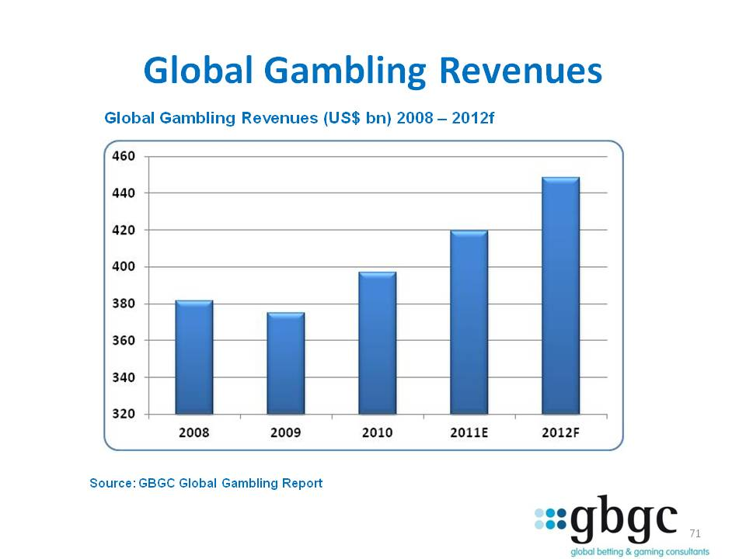
(2) gambling revenue

Slide 10
Case of Macao
Yat Yuen Canidrome Slot Lounge
  @Macau (YatYuen) Canidrome, 2005-present, owned by SJM
  逸園聚寶殿角子機娛樂場@逸園跑狗場內
Macau Jockey Club Slot Lounge,
  @Macau Jockey Club Racetrack, 2007-2012.11, owned by SJM
  澳門賽馬會角子機娛樂場@澳門賽馬會內
Notes:
澳門賽狗最初是在1932年由港澳商人合辦，經營模式和部份器材皆由當時上海兩個賽狗場引進來的，1942年～1963年曾停辦；1963年9月28日起由逸園賽狗會經營（何賢任當年董事長）至今（現為何鴻燊之集團名下）。以來自澳洲以專供狩獵用灰狗（即「格力狗」）比賽。
每週五天於澳門北區的逸園賽狗場進行，每晚進行16場比賽，賽事分350碼、510碼和550碼的中短途賽事。首場賽事於晚上7:45開始，每場賽事有六至八隻格力狗穿上不同顏色戰衣出賽。公眾席入場費為澳門日報電子版10圓（可用於投注）。包廂價錢為澳門日報電子版80圓（星期一至星期四）或澳門日報電子版120圓（星期五至星期日及公眾假期）另加每人最低消費30圓。場內設有酒吧、小食部及餐廳。參與博彩的人士可於賽狗會內進行投注，也可以於各場外投注站進行投注。賽狗吸納不少中國旅行團，現已成為中國旅行團必定參觀的一個觀光行程，成為澳門其中一個地標景點。
跟賽馬一樣，澳門三份報紙與少部分香港報紙皆刊有「狗經」，提供往狗隻詳細資料與往績、預測貼士等資訊；一直提供電台直播（綠&37032;電台AM），1992-1997年在澳廣視中文台提供賽事直播。現在蓮花衛視、香港有線電視19台與新經營之綠&37032;電台及網上直播賽事。

Slide 11
(1) betting turnover 2002-2012
Turnover | 2002 | 2003 | 2004 | 2005 | 2006 | 2007 | 2008 | 2009 | 2010 | 2011 | 2012
Greyhound Racing | 41.75 | 41.00 | 47.00 | 37.88 | 37.75 | 57.38 | 112.38 | 197.00 | 207.38 | 180.00 | 123.13
change% | - | -1.80% | 14.63% | -19.41% | -0.33% | 51.99% | 95.86% | 75.31% | 5.27% | -13.20% | -31.60%
Horse Racing | 340.38 | 650.88 | 1,021.63 | 410.75 | 281.63 | 260.00 | 325.00 | 214.88 | 284.13 | 283.63 | 228.50
change% | - | 91.22% | 56.96% | -59.79% | -31.44% | -7.68% | 25.00% | -33.88% | 32.23% | -0.18% | -19.44%
Unit: USD million (USD 1 = MOP 8)
Notes:
Huge increase on greyhound racing turnover because the number of races and racing days increased rapidly.
With respect to SJM, we estimate the Yat Yuen Canidrome Slot Lounge represents significantly less than 1% of our 2012 EBITDA forecast.
http://uniongamingresearch.com/research/tag/SJM-Holdings

Slide 12
(2) Share of racing revenue in the total gross gaming revenue 2002-2012
GGR | 2002 | 2003 | 2004 | 2005 | 2006 | 2007 | 2008 | 2009 | 2010 | 2011 | 2012
Table Games | 2,743.63 | 3,554.50 | 5,092.25 | 5,599.63 | 6,821.25 | 9,928.50 | 12,889.88 | 14,108.25 | 22,465.63 | 32,055.25 | 36,361.88
% | 93.42% | 93.80% | 93.63% | 95.04% | 94.87% | 94.73% | 93.89% | 93.76% | 94.80% | 95.31% | 95.30%
Slots | 28.88 | 29.50 | 80.00 | 156.25 | 256.63 | 449.25 | 706.63 | 812.88 | 1,077.25 | 1,428.13 | 1,655.50
% | 0.98% | 0.78% | 1.47% | 2.65% | 3.57% | 4.29% | 5.15% | 5.40% | 4.55% | 4.25% | 4.34%
Greyhound Racing | 9.50 | 9.25 | 10.50 | 8.38 | 8.38 | 12.25 | 23.25 | 40.88 | 42.50 | 37.13 | 25.63
% | 0.32% | 0.24% | 0.19% | 0.14% | 0.12% | 0.12% | 0.17% | 0.27% | 0.18% | 0.11% | 0.07%
Horse Racing | 67.38 | 125.50 | 195.75 | 79.50 | 54.63 | 50.38 | 62.63 | 41.63 | 55.00 | 55.00 | 44.50
% | 2.29% | 3.31% | 3.60% | 1.35% | 0.76% | 0.48% | 0.46% | 0.28% | 0.23% | 0.16% | 0.12%
Lotteries | 87.63 | 70.63 | 60.38 | 48.00 | 49.25 | 40.50 | 45.88 | 44.25 | 58.13 | 56.75 | 66.88
% | 2.98% | 1.86% | 1.11% | 0.81% | 0.68% | 0.39% | 0.33% | 0.29% | 0.25% | 0.17% | 0.18%
Total (100%) | 2,937.00 | 3,789.38 | 5,438.88 | 5,891.75 | 7,190.13 | 10,480.88 | 13,728.25 | 15,047.88 | 23,698.50 | 33,632.25 | 38,154.38
Unit: USD million (USD 1=MOP 8)

Slide 13
Future of Racinos in Macao
Failed cases
Beaten by the“real” casinos
Better close
Hardly reopen
Notes:
Macao government passed a law last year that among 11 slot lounges which are not located in casinos, 5 should be removed from the residential areas. Unfortunately, the dog racecourse is one of the five.

Slide 14
Any Questions?
Susan Shuang LIU
Gaming Teaching and Research Centre Macao Polytechnic Institute
Email: liushuang@ipm.edu.mo
Tel: +853 8893 6224
Fax: +853 2883 1746

