Slide 1
Macau as a gambling city observations through visual anthropology
Jukka Jouhki, PhD
Senior Researcher
University of Jyväskylä
Finland
jukka.jouhki@jyu.fi
Ronan Browne, MA
Producer
Full Focus Media
Finland
ronan@fullfocus.fi
The Second Asia Pacific Conference on Gambling & Commercial Gaming Research (APCG2013) 1-4 December 2013, Kaohsiung, Taiwan

Slide 2
“monte carlo of the orient”
“asian las vegas”

Slide 3

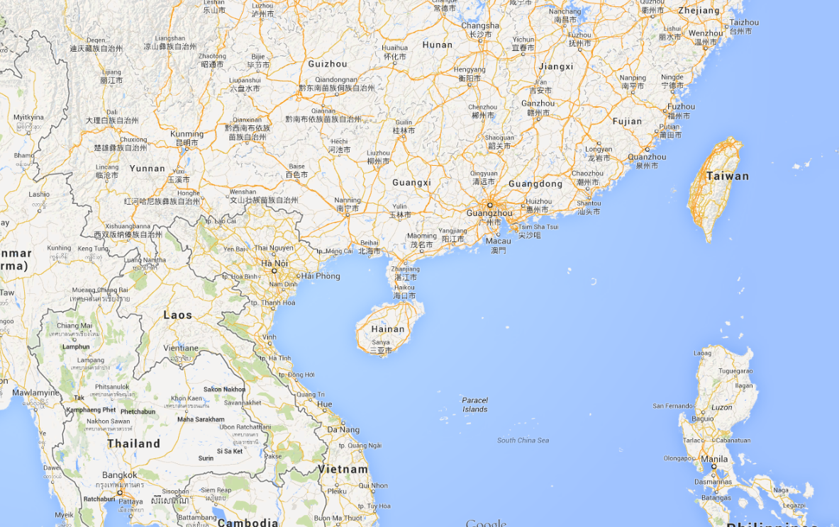
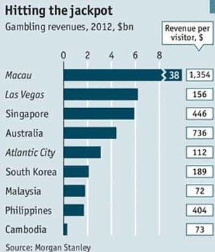
Population 560 000
Area 29 km²
Population density 20 500 persons/km²
Gambling/tourism driven economy
28 million visitors in 2012
$ 38 billion in gaming revenue in 2012
6 x Las Vegas

Slide 4
MACAU AND GAMBLING
Gambling has been legal since the 19th century but…
it was not until the turn of the millennium that the gambling industry started to boom after the closing of the state monopoly
Macau surpassed Las Vegas as the world’s top gambling destination in 2006, and is now the biggest gambling center in the world measured in terms of turnover

Slide 5
“casino mecca of the world”
“The Best Casino Market On Earth”
“What happens in Vegas...
Is nothing compared to Macau”
“VEGAS ON STEROIDS”
“Vegas is the Macau of America”

Slide 6
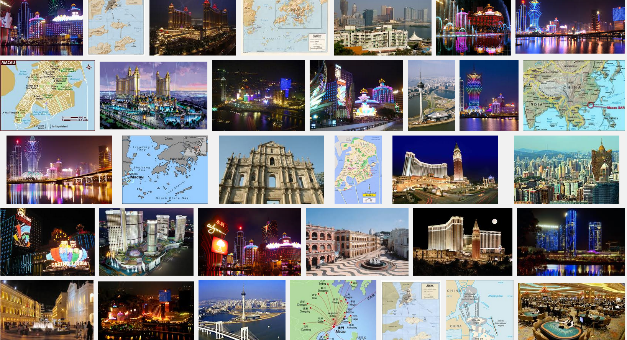

Slide 7
A PROJECT IN THE MAKING
”Macau: A Film Ethnography on Gambling and Cityscape” (Jouhki & Browne)
There are few studies that have applied visual anthropology and/or film ethnography to examine Macau as a gambling city
How gambling is viewed and experienced in Macau
How Macau’s public space is embedded with objects of gambling culture whether it be the actual gambling venues or related artifacts, advertising, monuments, gambling tourists etc.
The project is ongoing and will result in a full-length ethnographic film documentary after the main fieldwork trip to Macao in 2014.

Slide 8
[10 minute film]

Slide 9



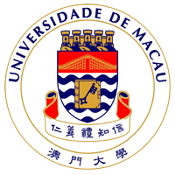
FINNISH FOUNDATION FOR GAMING RESEARCH
THANK YOU!

