Slide 1
The Impact of Non-problem Gambling on Gamblers
Guihai (Samuel) Huang, Ph.D.
APCG2013
December 1 to 4, 2013,Kaohsiung, Taiwan

Slide 2
Outline
Background
Literature Review
Data and Methodology
Analysis and Discussion

Slide 3
Background
The gaming industry has expanded exponentially in the past thirty years. However, the attitude towards gambling is still very controversial.
  A strong majority(85%) of Americans view casino gaming as acceptable for themselves or others (2013 State of the States).
  Historically gambling has been regarded sinful, immoral and has been related with crime and is still illegal in many countries like Indonesia, Mainland China.
Notes:
Gambling is illegal in Indonesia. This primarily stems from a devotion to the religion of Islam, which forbids activities such as gambling and drinking alcohol.
In the past, Indonesia had a state-run lottery, but it drew protests from Muslim students and activists. They asserted that the poor citizens of the country were spending all their money on the lottery in an attempt to escape poverty. Others believed that lottery money was being funneled to the family of the country’s president at the time. For these reasons, the lottery was discontinued.
In the northern province of Aceh, the punishment for illegal gambling is caning. In 2005, four women were found guilty of gambling, and each received seven strikes from a 1-meter long rattan cane. The punishment took place in front of a crowd of thousands. Earlier that year, 15 men were also caned for gambling.
the punishment for illegal gambling is caning.
14% not acceptable for anyone
Gambling violates Bible or Koran principles,
Shaffer, Howard J., & Martin, Ryan. ,2011)). Disordered Gambling: Etiology, Trajectory, and Clinical Considerations. Annual Review of Clinical Psychology, 7(1), null. doi: doi:10.1146/annurev-clinpsy-040510-143928
Rickwood, Debra, Blaszczynski, Alex, Delfabbro, Paul, Dowling, Nicki, & Heading, Katharine (2010). The psychology of gambling Retrieved from http://www.psychology.org.au/Assets/Files/APS-Gambling-Paper-2010.pdf
Hodgins, David C., Stea, Jonathan N., & Grant, Jon E. (2011). Gambling disorders. The Lancet.

Slide 4
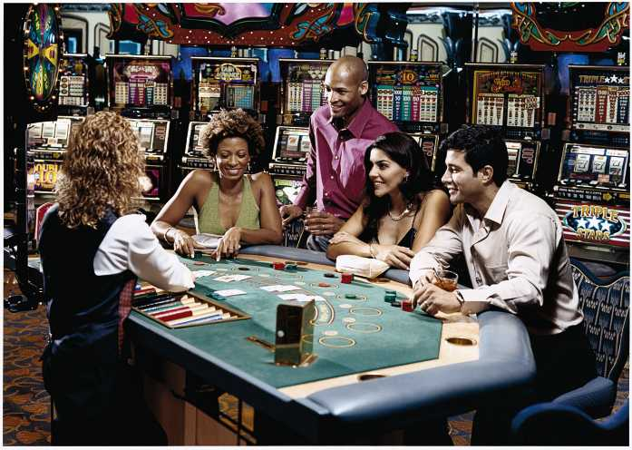
Gambling is Fun?

Slide 5
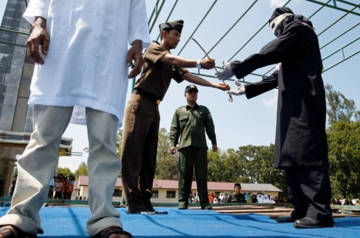
Or Gambling is a crime?
A government prosecutor hands over the whip to the executioner during a public caning at the compound of a mosque of a man, left, arrested for gambling in Aceh Besar on January 29, 2010. (AFP Photo/Chaideer Mahyuddin)

Slide 6
Literature Review
The impact of non-problem gambling is also controversial
  Many scholars assume that non-problem gambling has no harm. It is self-evident and systematic evidence is not necessary.
  Casino gaming has been legalized since 1847 in Macao, but many residents believe that gambling itself is irresponsible. Responsible gaming does not exit at all.
  Thompson & Potts( 2011): Gamblers seem to be happier than non gamblers.
  But no difference has been documented between problem gamblers and non-problem gamblers
Notes:
Problem gambling has been the focus of gambling studies(Shaffer & Martin, 2011, Hodgins, Stea & Grant, 2011).

Slide 7
Does non-problem gambling have negative or positive impact on gamblers?

Slide 8
Data
Telephone Survey
Time: October 14 to December 15, 2011
Participants: Macao residents, 18 years old or above
Sample Size: 2289
Questionnaire:
  Gambling behavior in the past 12 months
  DSM-Ⅳ-TR
  Perceived Social Support from Family, PSS-Fa (Procidano & Heller,1983).
  General Health Questionnaire (GHQ-12, Goldberg et al., 1997)
  Social and economic profile...
Notes:
(Procidano, M. E., & Heller, K. (1983). Measures of perceived social support from friends and from family: Three validations studies. American Journal of Community Psychology, 11(1), 1-24.
Goldberg, D. P., Gater, R., Sartorius, N., Ustun, T. B., Piccinelli, M., Gureje, O., & Rutter, C. (1997). The validity of two versions of the GHQ in the WHO study of mental illness in general health care. Psychological Medicine, 27 (1), 191-197

Slide 9
Participants Profile
Sex |  |  | Education
sample size | 2289 | 100% | F3 or below | 872 | 38.10%
male | 787 | 34.40% | F4-F6 | 653 | 28.50%
female | 1485 | 64.90% | Associate Degree or above | 664 | 29.00%
unknown | 17 | 0.30% | unknown | 100 | 4.40%
Age |  |  | Monthly Income
18-24 | 663 | 29.00% | none | 605 | 26.4%
25-34 | 310 | 13.50% | <10000 | 593 | 25.9%
35-44 | 374 | 16.30% | 10000-19999 | 533 | 23.3%
45-54 | 443 | 19.40% | 20000-29999 | 137 | 6.0%
55-64 | 285 | 12.50% | >30000 | 59 | 2.6%
65 or above | 197 | 8.60% | unknown | 363 | 15.9%

Slide 10
Gambling Activities in Last 12 Months
Gambling Activities | Participants | Percentage
Sample Size | 2275 | 100.0%
None | 1593 | 70.0%
At Least One Gambling Activity | 682 | 30.0%
Lottery | 432 | 18.9%
Social Gaming(Non commercial) | 220 | 9.6%
Macao Casino or Slot Lounge | 209 | 9.1%
Sports Betting(football or Basket ball) | 60 | 2.6%
Horse or Greyhound Racing | 45 | 2.0%
Mahjong(commercial) | 39 | 1.7%
Online Gambling | 12 | 0.5%
Notes:
The gambling participation rate is lower that Gambling Behavior Survey55.9%(Ozorio, Bernadete and Fong, Ka Chio, 2010), but similar to 41.87%Vong, Chuk Kwan Fanny(2004)

Slide 11
Problem Gambling Prevalence Rate
Types | Persons | Pravalence
Problem Gamblers (3 or above) | 41 | 1.79%
At-Risk Gamblers( 1 or 2) | 82 | 3.59%
No-Problem Gamblers | 559 | 24.45%
Non-Gamblers | 1604 | 70.17%
Total | 2286 | 100.00%

Slide 12
Perceived Social Support from Family
Types | Persons | Mean | Std. Err. | 95% Conf. Interval
Problem Gamblers | 41 | 11.34 | 0.90 | 9.57 | 13.11
At-Risk Gamblers | 82 | 14.02 | 0.58 | 12.89 | 15.16
Non-Problem Gamblers | 559 | 15.80 | 0.17 | 15.47 | 16.13
Non-Gamblers | 1604 | 15.48 | 0.11 | 15.26 | 15.70
Total | 2286 | 15.43 | 0.09 | 15.25 | 15.61
The full score of Perceived Social Support from Family is 20. Higher score means higher perceived social support form family. The range for non-clinical samples is11.60-14.28, averaged at12.70, while the range for clinical samples is 7.19-11.34, averaged at 9.25. The difference is significant.
Notes:
家庭支持量表滿分20分，得分越高，說明受訪者感知的家庭支持越高。文獻中非臨床樣本在11.60-14.28之間，總平均值為12.70，而臨床樣本在7.19-11.34之間，總平均值為9.25，兩者差異具顯著性。

Slide 13
Gambling behavior and Mental Heath
Types | Persons | Mean | Std. Err. | 95% Conf. Interval
Problem Gamblers | 41 | 2.71 | 0.59 | 1.55 | 3.87
At-Risk Gamblers | 82 | 1.23 | 0.22 | 0.81 | 1.66
Non-Problem Gamblers | 559 | 0.80 | 0.08 | 0.64 | 0.95
Non-Gamblers | 1604 | 0.75 | 0.04 | 0.66 | 0.84
Total | 2286 | 0.81 | 0.04 | 0.74 | 0.89
The highest score of the general health questionnaire is 12, higher score means more serious health problem. Score 0 or 1 means normal. 3 or higher means probable mental health disorder.

Slide 14
Who is happier?
Overall your quality of life in Macao is:
Very good
Good
Bad
Very Bad
Don’t know?
Refuse to answer

Slide 15
Overall Quality of Life in Macao
Types of Reponses | Participants | Percentage
very good | 135 | 6.0%
good | 1658 | 73.5%
bad | 291 | 12.9%
very bad | 41 | 1.8%
don't know | 108 | 4.8%
refuse to answer | 23 | 1.0%
Total | 2256 | 100.0%

Slide 16
non-gamblers are happier than gamblers
Quality of life | Non-gamblers |  | Gamblers |  | Total
very good | 105 | 7.1% | 30 | 4.7% | 135 | 6.4%
good | 1,172 | 78.8% | 486 | 76.3% | 1,658 | 78.0%
bad | 185 | 12.4% | 106 | 16.6% | 291 | 13.7%
very bad | 26 | 1.7% | 15 | 2.4% | 41 | 1.9%
Total | 1,488 | 100.0% | 637 | 100.0% | 2,125 | 100.0%
Pearson chi2(3) = 10.8354 Pr =0.013
Cramer's V =0.0714

Slide 17
Non-problem Gamblers and non-gamblers are similar
Quality of life | Non-Gamblers |  | Non-Problem Gamblers |  | Total
very good | 105 | 7.1% | 22 | 4.2% | 127 | 6.3%
good | 1,171 | 78.7% | 412 | 78.6% | 1,583 | 78.7%
bad | 185 | 12.4% | 80 | 15.3% | 265 | 13.2%
very bad | 26 | 1.7% | 10 | 1.9% | 36 | 1.8%
Total | 1,487 | 100.0% | 524 | 100.0% | 2,011 | 100.0%
Pearson chi2(3) = 7.4324 Pr = 0.059 Cramer's V =0.0608

Slide 18
Non-problem gamblers are happier than At-risk or Problem gamblers
Quality of life | Non-problem Gamblers |  | At-risk or Problem Gamblers |  | Total
very good | 22 | 4.2% | 8 | 7.0% | 30 | 4.7%
good | 412 | 78.6% | 75 | 65.8% | 487 | 76.3%
bad | 80 | 15.3% | 26 | 22.8% | 106 | 16.6%
very bad | 10 | 1.9% | 5 | 4.4% | 15 | 2.4%
Total | 524 | 100.0% | 114 | 100.0% | 638 | 100.0%
Pearson chi2(3) = 9.2518 Pr = 0.026 Cramer's V = 0.1204

Slide 19
Preliminary Conclusions
Non-problem gambling has no significant impact on gamblers’ general health, family functioning or the overall quality of life. Gambling can be an entertainment for non-problem gamblers.
At-risk gambling and problem gambling do have negative impact on gamblers’ general health, family functioning or the overall quality of life.
Non-gamblers are more satisfied with their quality of life.
Restrictions: cross-sectional data.

Slide 20
Guihai (Samuel) HUANG, Ph.D.
Director-General
  Asia Pacific Association for Gambling Studies(APAGS)
  www.gamblingstudies.org apa4gs@gmail.com
Associate Professor
  Gaming Teaching and Research Centre
  Macao Polytechnic Institute
  Tel: (853)8893 6228 Fax: (853)2883 6321
  Email: ghhuang@ipm.edu.mo
  www.ipm.edu.mo, gtrc.ipm.edu.mo

