Slide 1
The third place: A sociological investigation of quasi-legitimate gambling houses in Hong Kong
Paul V. Khiatani¹
Kelvin Yick²
Chine Chan²
Tiffany Tse²
Dr. Chan Chi Chuen³
¹ City University of Hong Kong
²Upper Iowa University
³University of St. Joseph

Slide 2
Agenda
Background
Research questions and purpose
Methodology
Procedures
Results
Discussions
Limitations
Directions for future research
References

Slide 3
Background
‘Third place’ – a neutral place where people can go to regularly meet for relaxation outside of home or work (Oldenburg, 1991).
Quasi-legitimate gambling houses – gambling venues that are not legal nor entirely illegal.
Why this specific investigation?

Slide 4
Background
History of Triad societies (mid-17th Century – Present)
Supposedly formed in the mid 17th Century by Shaolin monks to overthrow the Qing government and restore the Ming dynasty (Chu, 2000)
After overthrowing the government, the PRC was formed and the ‘Triads’ (termed by the West) had a shift in focus from political endeavours to criminal enterprise endeavours (Chu, 2000)
Notes:
Book: The Triads as Business (Chu, Y.K., 2000)

Slide 5
Background
Involvement of the triads in everyday social life:
  Legal markets (e.g. transportation, protection)
  Illegal markets (e.g. gambling, drug dealing, prostitution)
  International markets (e.g. drug trafficking, human smuggling)
Notes:
Book: The Triads as Business (Chu, Y.K., 2000)

Slide 6
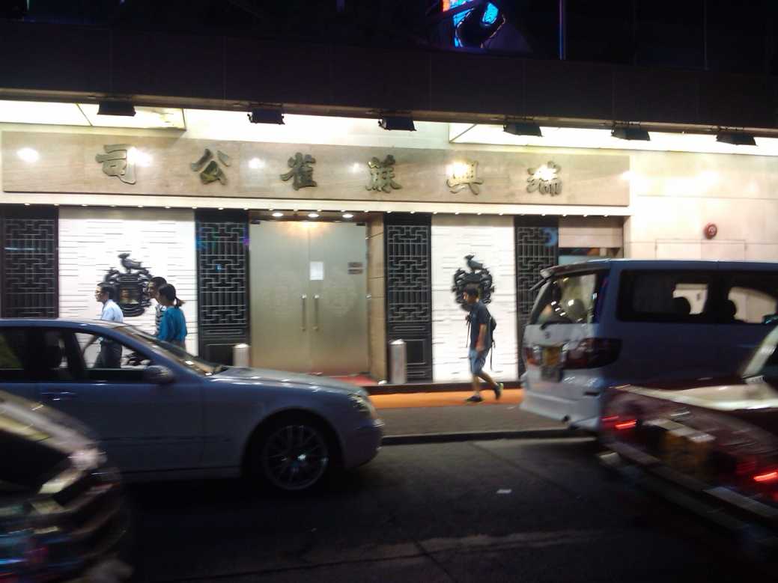
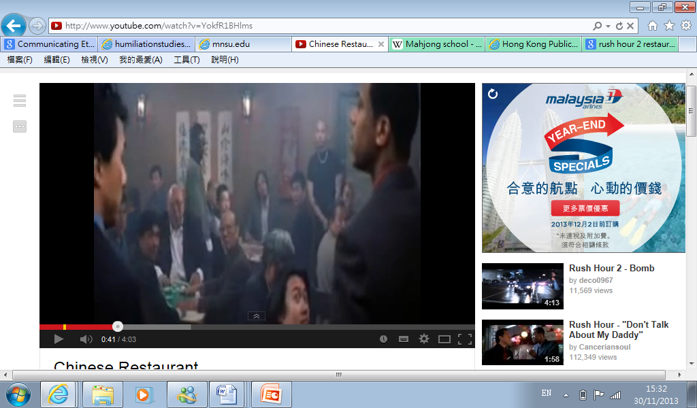
Background
Illegal market: Gambling
Involvement in gambling:
  Book-keeping
  Protection
  Running gambling operations
    Legal Mahjong houses (Mahjong school)
    Illegal Mahjong house

Slide 7
Background
Gambling houses, Gambling schools, Gambling dens, Gambling hell, Gambling parlours, etc. Many names for the same thing.
  An establishment in which a variety of games of chance can be played.
Often involves more than one game (E.g. Mahjong and Pai gow, Mahjong and racetrack betting) and more often that not the establishment is considered illegal/deviant (depends on geographical location and laws).

Slide 8
Background
Quasi-legitimate mahjong house involves the operation of both legitimate and illegitimate Mahjong houses:
  Legitimate Mahjong house (must close before midnight; 12 to 12)
  Illegitimate Mahjong house (24 hours)
Quasi-legitimate Mahjong House = Legal Mahjong house + Illegal Mahjong house

Slide 9
Background
Gambling houses are rife in a select few areas in Hong Kong: Particularly Mong Kok, Yau Ma Tei, and Sham Shui Po.
Despite its prominent presence, gambling houses/schools have not been studied extensively locally in Hong Kong.
There are a couple of articles (especially from newspapers) describing it at face value, but, in general, there is a lack of research investigating the meaning of gambling houses to gamblers and the culture in gambling houses.

Slide 10
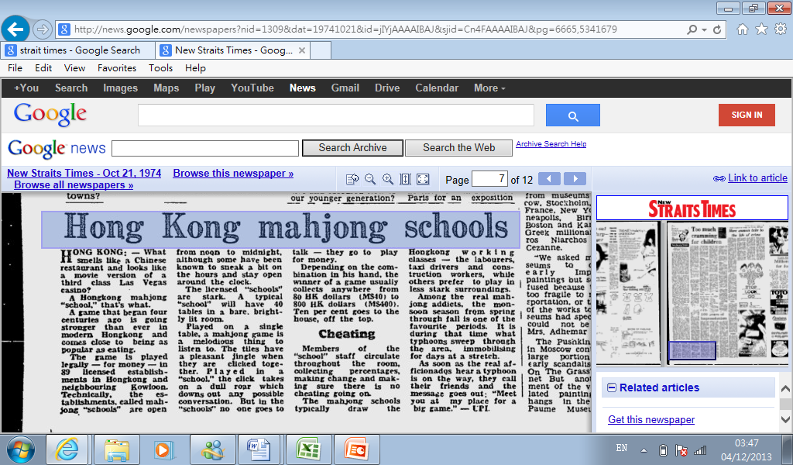

Slide 11
Research questions and purpose
Research scope: Gamblers and triad members involved with quasi-legitimate mahjong gambling houses in Hong Kong.
Research questions:
  RQ1: How does the quasi-legitimate gambling house work?
  RQ2: Why do people go to quasi-legitimate gambling houses?
  RQ3: What is the culture of the quasi-legitimate gambling house?

Slide 12
Methodology
Qualitative research (semi-structured, in-depth interview)
N=15 (individuals who gamble, work, or gamble and work in Quasi-legitimate gambling houses)
Inclusion criteria:
  18+ years old
  Chinese or English language competency
  Works, gambles, or works and gambles in Mahjong houses

Slide 13
Procedures
Participants were briefed about the study prior to the formal interview and were provided the option to have pseudonyms and age ranges (5pt, 10pt increments).
Participants could exit whenever they wanted.
Recruit (Chain sampling) → Briefing and verbal/written consent → Semi-structured interview (provided cash incentive after completion)

Slide 14
Pseudonyms | Sex | Age range | Education | Relationship status | Occupation
Participant 1 | Male | 40-50 | Secondary | Widow | Fighter (Manager)
Participant 2 | Male | 50-60 | Secondary | Single | Leader (Owner)
Participant 3 | Male | 35-45 | Secondary | Single | Leader
Participant 4 | Female | 20-30 | Secondary | Single | Night club sex worker
Participant 5 | Female | 30-40 | None | Married | Night club & street sex worker
Participant 6 | Female | 30-40 | Primary | Married | Night club & street sex worker
Participant 7 | Male | 40-50 | Primary | Married | Leader
Participant 8 | Male | 55-65 | Secondary | Married | Leader
Participant 9 | Female | 20-30 | Secondary | Single | Night club sex worker
Participant 10 | Female | 30-40 | Secondary | Single | Night club sex worker
Participant 11 | Male | 55-65 | Primary | Married | Owner, leader
Participant 12 | Male | 50-60 | Primary | Married | Owner, leader
Participant 13 | Female | 30-40 | Secondary | Single | Night club sex worker
Participant 14 | Female | 30-40 | Secondary | Single | Night club & street sex worker
Participant 15 | Male | 40-50 | Primary | Girlfriend | Leader

Slide 15
Results
How does the quasi-legitimate gambling house work?
Starts off with the legal gambling house (public venue with licence).
  Very big (30-70 tables); well decorated outside and inside.
  Triad/Non-triad staff legally working there
  Open to all (male dominant; different ethnicities)
  Expensive food and beverages on offer for customers. Can call taxis for those who need to travel far afterwards.
  Mahjong machine tables and cameras to combat cheating.
  Winner has to ‘Chow Seui’ (5%)

Slide 16
Results
How does the quasi-legitimate gambling house work?
After the legal gambling houses closes, then comes the illegal gambling house (unlicensed).
  Interested gamblers can transition to the illegal gambling houses that ‘float’ around the legal gambling house.
  Small space (3-4 tables); No decorated outside and inside.
  All of the staff working there are from the Chinese triad
  Open only to those with connections and by invitation (male dominant)
  Simple food, drinks, and requests can be made. Drugs can also be obtained by asking (Ice in most cases).
  Some are Mahjong machine tables, some are not. No cameras.
  Winner has to ‘Chow Seui’ (5%)

Slide 17
Results
Readily available:
Taxis
Convenience stores (e.g. 7-11)
MTR station
Illegal Mahjong houses
Private
All day (peak after 12am)
Legal Mahjong house
Public
12pm-12am
Within walking distance

Slide 18
Results
Why do people go to quasi-legitimate gambling houses?
  It’s a place to socialize and make new connections
  A social world separate from reality (stripped of all labels)
  Material (e.g. money)/Immaterial rewards (e.g. ‘facework’)
  Affordable
  Personalized treatment
  Can be yourself or assume new identity
‘’Sometimes housewives will come to gamble and they want us to remind them when to pick up their son/daughter from school or they need to buy some groceries…we will remember it and approach her to remind her of it’’
  Participant 1 (Male triad veteran, manager)
‘’I am respected and treated like a VIP in the Mahjong house…Outside the Mahjong house, I have labels…even though I go to Macao, it’s not the same as going to a Mahjong house’’
  Participant 4 (Female sex worker, gambler)

Slide 19
Results
‘’People love gambling…I travel everywhere to gamble…In my houses, I tell my followers to socialize with the gamblers and collect debts and loan money when the gamblers need it’’
  Participant 12 (Male triad leader, owner)
‘’People gamble in my houses because I make sure that their needs are met and they’re never not playing…If they’re one man less, I’ll join in and play and socialize with them’’
  Participant 11 (Male triad leader, owner)
‘’They come to us because we treat them well…I’ll play with anyone, even strangers…I want them to feel welcomed and feel like this is home’’
  Participant 2 (Male triad leader, owner)

Slide 20
Results
‘’In the gambling house, I feel happy because I feel cared and not alone…I can receive a lot of attention and can easily make friends with people there…’’
  Participant 5
‘’The Mahjong house can provide me with a lot of things; I can play Mahjong, buy drugs, get clients, and receive attention…I always go to Mahjong houses when I’m free and want to escape my sadness’’
  Participant 9
‘’Gambling in Mahjong houses is very convenient for me…It’s easy to access and I can gamble there whenever I’m free…I can borrow how much money I want from the loansharks there and keep on playing until I need to go.’’
  Participant 14

Slide 21
Results
Culture of the Quasi-legitimate house?
  Keep those you trust close
  Respect each other
  Fairness above all; no cheating
‘’I trust the customers…if they want to borrow a lot of money, I will lend it to them in cash…I trust they will come back and will pay back’’
  Participant 8 (Male triad leader, gambler)
‘’We trust each other very much and treat each other with respect…you respect me I respect you. If you cheat, in the legal Mahjong house, we will take you outside and beat you up and take your money…you’ll be banned from entering again. If you cheat in the illegal gambling venues, we will beat you up on the spot and take everything you have.’’
  Participant 1 (Male triad veteran, manager)

Slide 22
Results
‘’Respect is important in the house…if someone argues with another or behaves violently and disrespectfully, he/she will directly be escorted out…’’
  Participant 15 (Male triad leader, gambler)
‘’If I don’t know someone, I won’t play with him and won’t lend him money…’’
  Participant 7 (Male triad leader, gambler)
‘’Trust is important in illegal gambling house; in the legal gambling house, it is not as important…’’
  Participant 3 (Male triad leader, gambler)

Slide 23
Results
‘’Mahjong house workers and gamblers treat each other well and with respect…I like that…’’
  Participant 13 (Female sex worker, gambler)
‘’We all respect each other and play fairly…just have fun and socialize’’
  Participant 10 (Female sex worker, gambler)
‘’I try to win their trust…if I can win their trust, more opportunities are open’’
  Participant 6 (Female sex worker, gambler)

Slide 24
Discussions
Quasi-legitimate gambling houses in Hong Kong are more than just your average gambling venue.
They are a ‘third place’ for the gamblers that frequent the houses and are able to develop a ‘sense of belonging’ and ‘membership’ to the houses.
In the house, a culture of respect, fairness, and trust exists.

Slide 25
Discussions
What makes this gambling culture unique from other gambling institutions and establishments?
Casinos vs. Quasi-legitimate gambling house. E.g.
  Former = personalized treatment comes at a hefty price; Latter = personalized treatment for all regulars!
  Former = Designed to ‘detach’ from the outside; Latter = No such thing (clocks, windows, open doors, are always available)
Has a similar culture been found before in another institution/establishment? If so, which one?

Slide 26
Discussions
The present study supports scholars (e.g. Rosecrance’s Interactional Theory) who claim that the gambling venues constitutes a distinct social reality/world.
As gamblers increasingly commit to gambling, their social life begins to revolve around their gambling associates (in this case, the Chinese triad and other regular gamblers) and they form a ‘sense of belonging’ with the venue and identify with the associates. Time, play, and money takes new forms.
Gambling persists despite financial losses for the reward of social interaction with others who share this commitment with them; immaterial rewards>material rewards.

Slide 27
Limitations
Individuals interviewed were all ‘’socially deviant’’ characters (from the triad or sex workers). None of the interviewed were not socially deviant characters (E.g. gambling housewives, Filipino staff, Middle-eastern gamblers)
Wasn’t able to directly observe them play or go inside the quasi-legitimate gambling house to observe.

Slide 28
Directions for future research
Encourage further research to delve into the different social systems various gambling venues follow and identify the impacts of various gambling venues on the gambling pathway of the gambler.
Explore the unexplored! More explorative research in non-formal gambling venues.

Slide 29
References
Chu, Y.K. (2000). The Triads as Business. London and New York: Routledge.
Oldenburg, R. (1991). The Great Good Place. New York: Marlowe & Company.

Slide 30
Contact: founderstar@hotmail.com
Q&A session. ☺
Thank you for your attention!

