Slide 1
The Second Asia Pacific Conference on Gambling & Commercial Gaming Research (APCG2013)
Key Features of Proposed Casino Control Act &
Integrated Resort Investment Regulation
Lin & Partners Attorneys-at-Law
Managing Partner George Lin
December 3, 2013
Copyright © 2013 Lin & Partners Attorneys-at-Law

Slide 2
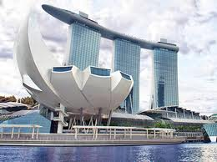
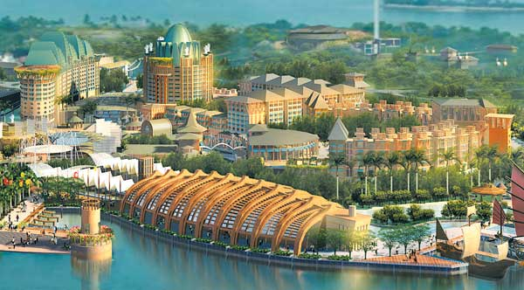
A. Principles & Legal Framework of Casino within Integrated Resort in Taiwan
Reference to Singapore’s Integrated Resort Model: a casino must operate within an integrated resort whose facilities include hotel, shopping center, M.I.C.E, and tourism facilities.
Locations of Casino:
Offshore islands where a referendum in favor of casino industry has been passed.
Legal Framework:
Casino Control Act (觀光賭場管理條例): 400 articles and 20 enforcement rules governing the establishment and operation of casino, the qualification of its operator, shareholders, key employees, patrons and etc..
Integrated Resort Investment Regulation (國際觀光度假區投資計劃審查辦法): governing the license permit of Integrated Resort, such as its procedure, application, review, scoring system, and review committee for permit.
Marina Bay Sands
Resort World Sentosa

Slide 3
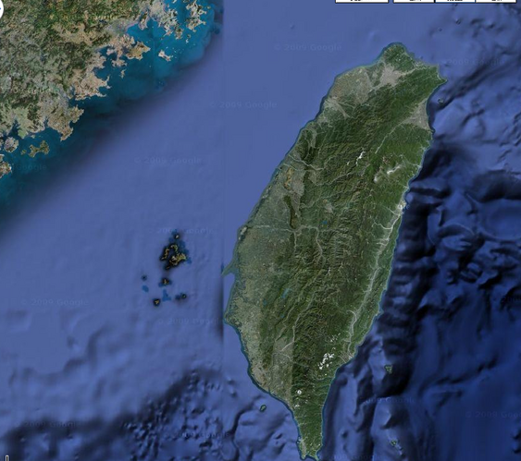
B. Locations of Six Offshore Islands of Taiwan
Offshore Island | Area (KM²) | Population | Casino Referendum History
Matsu (馬祖) | 116.8 | 10,084 | Passed in July, 2012
Kinmen (金門) | 150 | 100,000 | -
Penghu (澎湖) | 141.1 | 97,000 | Failed in Sep, 2009
Linqiu (小琉球) | 6.8 | 13,000 | -
Green Island (綠島) | 16 | 3,000 | -
Lanyu (蘭嶼) | 46 | 4,664 | -
Matsu
Taipei
Taoyuan
Xiamen
Kinmen
Penghu
Kaohsiung
Green Land
Liuqiu
Lanyu

Slide 4
C. Current Status of the Bill of Casino Control Act and Draft of IR Regulation
Bill of the Casino Control Act
Completed in Jan, 2013 by Lin & Partners, selected by the MOTC (the designated casino authority) among 9 international consortiums in 2010.
Approved by the Central Government on May 2, 2013.
Listed in priority bills by the Congress in Sep, 2013.
Scheduled to be discussed in the public hearing held by the Congress in Dec 4, 2013.
Scheduled to be reviewed by the Congress from Dec 5, 2013.
Draft of the Integrated Resort Investment Regulation
Completed by the MOTC in Oct, 2013.
Scheduled to be submitted to Executive Yuan in Nov, 2013, the top executive branch of R.O.C, for its approval.

Slide 5
D. Casino License and its Application
Number of License: Determined by Executive Yuan referring to local government’s recommendation based on the feasibility study or RFC
Term of License: Initially 30 years and renewable for another 30 years if the casino operates pass the evaluation conducted by casino authority as sound operators
Real Property of Casino: Casino operator may either acquire on its own or lease from local government
Ratio of Gaming Floor to IR Floor: 5%.
One single operator for IR and casino: One operator is required to run both of IR and casino
Four Steps of Application of casino license
Step 1: Apply for and pass the suitability review
Step 2: Apply for and obtain IR investment permit
Step 3: Apply for and obtain casino construction permit
Step 4: Apply for and obtain casino license

Slide 6
E. Process to Obtain Casino License
1
Casino Control Act passed by Congress .
2
Offshore island referendum in favor of casino industry
“Request for Concept” conducted by local government
8
Application for casino establishment permit
5
3
4
6
7
Tourism Bureau reviewed the feasibility report submitted by the local government
Announcement of tender for IR & casino license (D Day)
Application for & approval of 1st suitability review
Preparation & filing of application for IR investment permit
Review & approval of IR investment permit
9
10
Construction of IR upon approved IR investment permit & casino establishment permit
Application for & approval of 2nd suitability review & casino license upon completion of first phase of IR construction
11
Casino Opening
IR Regulation passed by the Executive Yuan.
Est. Time from D-Day to casino opening: 1.Macau: D+ 24-36 months. 2.Singapore: D+ 48 months

Slide 7
F. Taxation, Levy, and Fees
Category | Tax Rate | Collection Agency | Use
1.Casino Tax | Up to GGR7% (Decided by local government) | Local Government | TBD by Local Government
2.Franchise Fee | 1st year to 15th year: GGR7% 16th year to 25th year: GGR 8% 26th year~: GGR 9% | MOF | Treasury Offshore Island Development Fund
3.Public Benefit Levy | GGR 0.5% | MOTC | Education, culture, medical, public health, and social benefit
4.Problem Gambling Prevention Fund | GGR 0.5% | Problem Gambling Foundation | Research and implementation on protection measures of problem gambling
Subtotal (Items 1-4) | GGR 15%-17%
5.License Fee | TBD by casino authority based on supervision cost (approximate 8~10 million USD per year) | MOTC | Casino Authority
6.Corporate Tax | 17% on Pre-Tax Profit | MOF | Central Government
May 21 – 23, 2013 | Venetian Macao

Slide 8
G. Casino Taxation Survey in Asian Countries
Jurisdiction | Gaming Tax (Based on Gaming Gross Revenue) | Corporate Tax (Based on Pre-Tax Profit) | Numbers of Casino (2013) | Tax revenue (USD,2012-2013)
Taiwan | 15~17% | 17% | - | -
Singapore | 5%+7%(VAT) for revenue from VIP 15%+7%(VAT) for revenue from mass | 17% | 2 | 10 billion
Macau | 39% | N/A | 35 | 160 billion
Malaysia | 25% | 25% | 4 | 700million
Philippines | 15% for premium players 25% for other players | N/A | 19 | 350 million
Vietnam | 20% | 30% | 3 | 80 million
Vladivostok | 3,750 USD per table 225 USD per slot | 20% | 4 | -
May 1 – 23, 2013 | Venetian Macao

Slide 9
H. Qualifications of Casino Operator & its Shareholders
Corporate Structure: Limited liability companies incorporated in Taiwan. One company is required to run both of casino and IR.
Minimum Paid-In Capital: TBD by casino authority, depending on respective situations of individual islands.
IR & Casino Experience: At least one main shareholder must have the experience in the management and operation of a casino-based integrated resort.
Foreign Ownership: No local-partner requirement & No foreign ownership restriction.
Capital Commitment & Non-Competition: Main shareholder must maintain at least 20% shares of casino operator for10 years and not own any share of any other Taiwan casino operator.
Main shareholder is one holding at least 20% in casino operator;
Major shareholder is one holding at least 5%

Slide 10
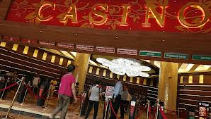
I. Other Key Points
Credit Gaming:
Eligibility for credit gaming: foreigners and premium players only (with more than 2 million in deposit account).
No credit card use/ATM within the casino.
Entry Restriction
Taiwan residents/foreigners: no limitation.
Local county residents: TBD by local government.
Protection Measures for Responsible Gaming
Admission age: 20 years old.
Three types of Exclusions: Self, Family, Third-Party.
Casino Advertisement restriction
Control loss mechanism & Intoxication controls within casino
Annual review on responsible gaming measures conducted by operators.
Junket
Subject to license requirement set by casino authority.
Maximum commissions: TBD by casino authority.

Slide 11
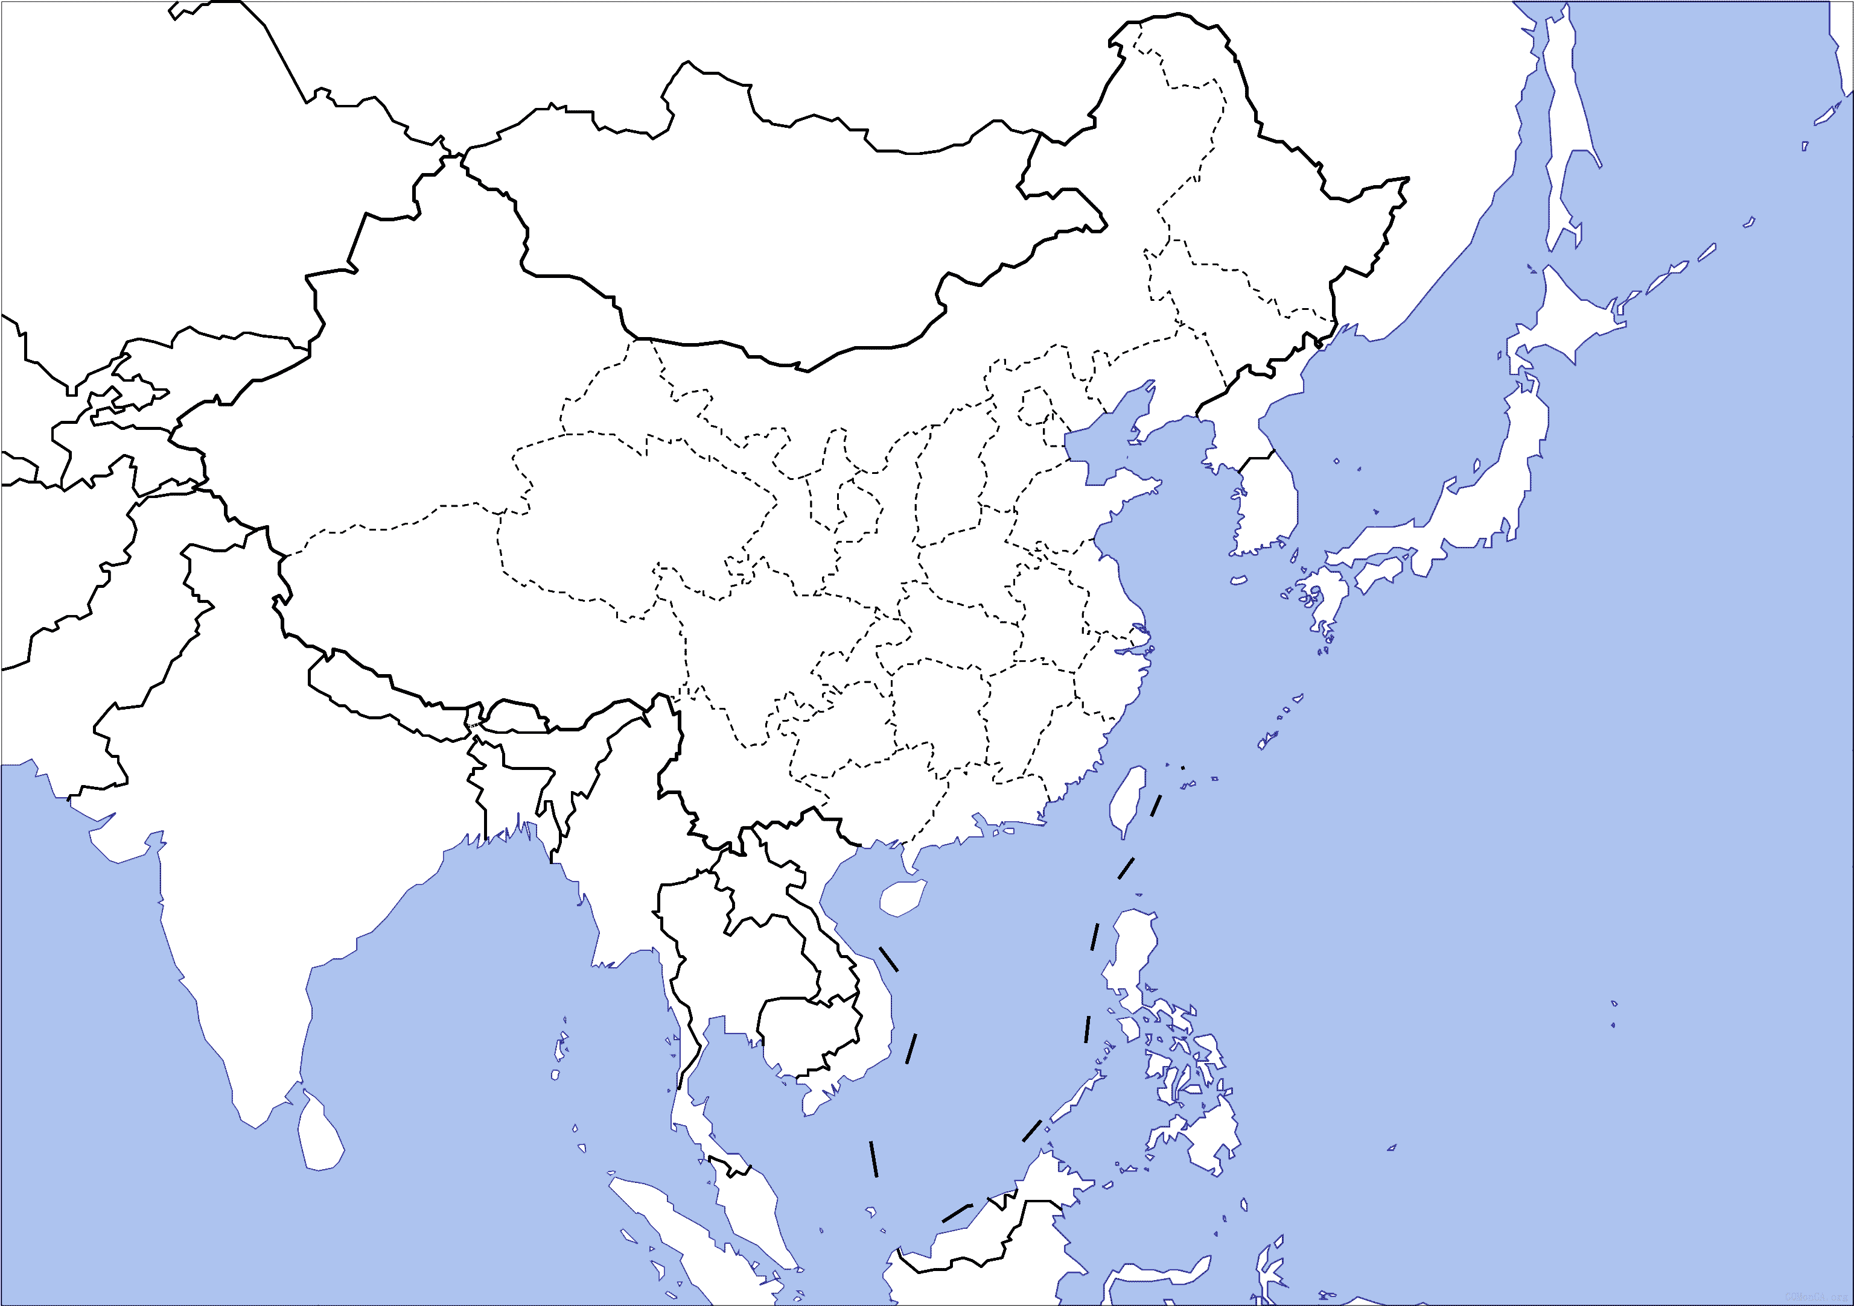
J. Trend of Casino Industry in Asia
Vladivostok
(4, under construction)
Mongolia (planning)
South Korea(17)
Japan (planning to introduce casinos in Tokyo & Osaka)
Taiwan (?)
Nepal (7)
Macau(35)
Cambodia(32)
Philippines (19)
Vietnam(3)
Malaysia(4)
Singapore (2)
Australia (12)

Slide 12
K. Top 10 casinos of the world
 | Name (Opening Time) | Location | Casino Operator | Scale of casino | Rooms | Construction Cost (USD)
1 | MGM City Center(2009) | Las Vegas | MGM Resorts Int’l | 14,000m2 | 6600 | 9.2 billion
2 | Marina Bay Sands(2010) | Singapore | Las Vegas Sands | 500 table/2500 slots 15,000 m2 | 2561 | 8 billion
3 | Resort World Sentosa(2009) | Singapore | Genting Group | 500 tables/ 2200 slots 15,000 m2 | 1,840 | 6.59 billion
4 | Sands Cotai Central(2011) | Macau | Las Vegas Sands | 350 table/ 2000 machine 27500 m2 | 5836 | 4.4 billion
5 | Galaxy Macau(2011) | Macau | Galaxy Entertainment | 450 tables/ 1000 slot | 2200 | 4.4 billion (including project phase 2)
6 | Wynn Cotai(2015) | Macau | Wynn Resorts | 500tables Slot /areas TBD | 2000 | 4 billion
7 | Baha Mar(2014) | Bahamas | Owned by Baha Mar Operated by GGAM | 150tables/ 1500 slots 9300m2 | 3100 | 3.5 billion
8 | Venetian Macau(2006) | Macau | Las Vegas Sands | 870 tables/ 3700 slots 35610 m2 | 3000 | 3 billion
9 | MGM Cotai(2015) | Macau | MGM | 2,500 slots 500 tables. | 1,600 | 2.5 billion
10 | City of Dreams(2009) | Macau | Melco Crown | 550 tables/ 1500slots 39000 m2 | 2200 | 2.4 billion
The ranking above is based on the construction cost of each casino resort

Slide 13
L. Closing Remark
“Gambling, over my dead body” (Responded to a proposal by Dr. Stanley Ho for a floating casino in Marina Bay, 2000)
"I don't like casinos, but the world has changed and if we don't have an integrated resort like the ones in Las Vegas, we'll lose. (New York Times, August 29, 2007)
By Mr. Lee Kuan Yew, Minister Mentor & former Prime Minister of Singapore

Slide 14
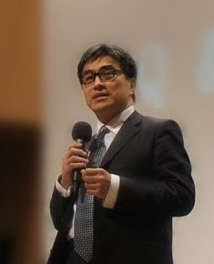
Introduction of Lin & Partners & Dr. George Lin
Dr. George Lin is the managing partner of Lin & Partners, one of the most prestige law firms in Taiwan. He has been ranked by Chambers Asia, Legal 500, AsiaLaw and other international ranking institutions as the best/Band 1 Banking and Finance lawyer in Taiwan. Lin & Partners is also ranked as one of the best law firm in the practice area of Banking & Finance, Capital Market, Corporate M&A, Dispute Resolutions and Gaming.
Dr. George Lin and Lin & Partners currently is engaged by Taiwan Government to draft the most important economy development legislation i.e. Free Economic Pilot Zones. He is a very unique legal practitioner who is recognized globally with intensive legislation experience in Taiwan.
Managing Partner
Dr. George Lin
TEL:+886 2 2705-5929
FAX:+886 2 2731-2896
http://www.linandpartners.com.tw
Email:attorneys@linandpartners.com.tw

Slide 15
Thank you!!
Website: http://www.linandpartners.com.tw/
Email: attorneys@linandpartners.com.tw
DISCLAIMER:
The materials for this presentation on the ppt. slides are public information rather than legal opinions provided. Please be advised that Lin & Partners is NOT RESPONSIBLE for the ACCURACY and COMPLETENESS of the materials used for this presentation.

